Slide 1
Week 12
Alexey V. Zimin
JHU BME 580.417/707

Slide 2
Lab #6: Training and scoring with
PWM and WAM
Lab #6: Due Friday November 21st at 8:00pm. In this lab assignment you will implement training and scoring with Positional Weight and Weight Array (graduate only) matrices. Submit through GradeScope’s autograder.
Data: training https://github.com/alekseyzimin/BME-Algorithms-for-Analysis-of-Genomic-Data/raw/refs/heads/main/training.txt testing https://github.com/alekseyzimin/BME-Algorithms-for-Analysis-of-Genomic-Data/raw/refs/heads/main/testing20.txt. When computing logs of probabilities, add 1e-16 to the probability to avoid getting log(0)
The assignment is to write the following functions in python and submit them through autograder in train_score_pwm.py file:
  (G:10pts,U:10pts) load_sequences(file) : reads strings from file, one string per line, returns array of strings
  (G:25pts,U:50pts) compute_pwm(sequences) : computes positional weights from training data in the array of strings sequences, returns dictionary of positional weights pwm[base][position]=weight; base is “ACGT”, position is from 0 to len(sequences[0])-1
  (G:20pts,U:40pts) score_pwm(sequences,pwm) : returns array of numerical positional weight scores for array of DNA sequences sequences and positional weight matrix (dictionary) pwm
Graduate students only:
  (G:25pts) compute_wam(sequences) : computes Weight Array Matrix from training data in the array of strings sequences, returns dictionary of weights wam[tuple][position]=weight; tuple is “AA, “AC”,...,”TT”, position is from 0 to len(sequences[0])-2
  (G:20pts) score_wam(sequences,pwm,wam) : returns array of numerical Weight Array scores for array of DNA sequences sequences, positional weight matrix (dictionary) pwm, and weight array matrix (dictionary) wam

Slide 3
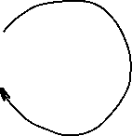
Viterbi algorithm for HMMs
Start
0.5
0.5
C
A 0.2
C 0.3
G 0.3
T 0.2
N
A 0.3
C 0.2
G 0.2
T 0.3
0.5
0.5
0.6
0.4
Let's consider the following simple HMM for coding/non-coding regions of DNA. This model is composed of 2 states, C (coding) and N (non-coding).

Slide 4
Viterbi algorithm for HMMs
Start
0.5
0.5
C
A 0.2
C 0.3
G 0.3
T 0.2
N
A 0.3
C 0.2
G 0.2
T 0.3
0.5
0.5
0.6
0.4
Consider the sequence S = GGCACTGAA
There are several paths through hidden states (C and N) that lead to this sequence, e.g. NNCCCCNNN
Prob(S) through this path is 0.5*0.2*0.6*0.2*0.4*0.3*...

Slide 5
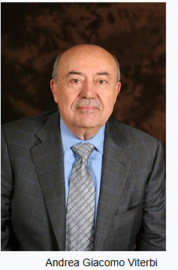
Viterbi algorithm for HMMs
Start
0.5
0.5
C
A 0.2
C 0.3
G 0.3
T 0.2
N
A 0.3
C 0.2
G 0.2
T 0.3
0.5
0.5
0.6
0.4
Andrew James Viterbi
Image credit: Wikipedia
Consider the sequence S = GGCACTGAA
There are several paths through hidden states (C and N) that lead to this sequence, but they do not have the same probability
The Viterbi algorithm allows us to compute the most probable (best) path

Slide 6
Viterbi algorithm for HMMs
S = GGCACTGAA
Dynamic programming (remember Smith-Waterman): iteratively compute probabilities, record values and where you came from in two matrices (arrays):
  dP – this is where we will record probabilities
  bT – this is where we will record back-trace (where we came from)
 | G | G | C | A | C | T | G | A | A
C
N
 | G | G | C | A | C | T | G | A | A
C
N

Slide 7
Viterbi algorithm for HMMs
Start
Consider the sequence S = GGCACTGAA
The probability of the best
path ending in state l
with observation i is:
0.5
0.5
C
A 0.2
C 0.3
G 0.3
T 0.2
N
A 0.3
C 0.2
G 0.2
T 0.3
0.5
0.5
0.6
0.4
$$p_{l}\left(i,x\right)=e_{l}\left(i\right)\max_{k=(N,C)}{(}p_{k}\left(j,x−1\right)∗p_{kl})$$
Probability to observe element i in state l
Probability of the best path ending at position x-1 in state k with element j
Probability of transition from state k to state l

Slide 8
Viterbi algorithm for HMMs
Start
Consider the sequence S = GGCACTGAA
The probability of the best
path ending in state l
with observation i is:
In our example, the probability of the best path ending in state l=C with “A” at the 4th position is:
0.5
0.5
C
A 0.2
C 0.3
G 0.3
T 0.2
N
A 0.3
C 0.2
G 0.2
T 0.3
0.5
0.5
0.6
0.4
$$p_{l}\left(i,x\right)=e_{l}\left(i\right)\max_{k=(N,C)}{(}p_{k}\left(j,x−1\right)∗p_{kl})$$
$$p_{C}\left(A,4\right)=e_{C}\left(A\right)\max_{k}{(}p_{N}\left(C,3\right)∗p_{NC},p_{C}\left(C,3\right)∗p_{CC})$$

Slide 9
Viterbi algorithm for HMMs
For simplicity, let’s convert
everything to log₂(p):
Start
0.5
0.5
C
A 0.2
C 0.3
G 0.3
T 0.2
N
A 0.3
C 0.2
G 0.2
T 0.3
0.5
0.5
0.6
0.4

Slide 10
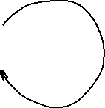
Viterbi algorithm for HMMs
For simplicity, let’s convert
everything to log₂(p):
This allows us to add
probabilities instead of
multiplying, which is
more efficient and accurate
Start
-1
-1
C
A -2.322
C -1.737
G -1.737
T -2.322
N
A -1.737
C -2.322
G -2.322
T -1.737
-1
-1
-0.737
-1.322

Slide 11
Viterbi algorithm for HMMs
Start
S = GGCACTGAA
Log probability that the first G
was emitted by state C:
Log probability that the first G
was emitted by state N:
-1
-1
C
A -2.322
C -1.737
G -1.737
T -2.322
N
A -1.737
C -2.322
G -2.322
T -1.737
-1
-1
-0.737
$$p_{C}\left(G,1\right)=−1−1.737=−2.737$$
-1.322
$$p_{N}\left(G,1\right)=−1−2.322=−3.322$$

Slide 12
Viterbi algorithm for HMMs
Start
S = GGCACTGAA
Log probability that the second G
was emitted by state C:
Log probability that the second G
was emitted by state N:
-1
-1
C
A -2.322
C -1.737
G -1.737
T -2.322
N
A -1.737
C -2.322
G -2.322
T -1.737
-1
-1
-0.737
-1.322
$$p_{C}\left(G,2\right)=−1.737+\max\left(p_{C}\left(G,1\right)+p_{CC},p_{N}\left(G,1\right)+p_{NC}\right)=−5.474$$
$$p_{N}\left(G,2\right)=−2.322+\max\left(p_{C}\left(G,1\right)+p_{CN},p_{N}\left(G,1\right)+p_{NN}\right)=−6.059$$

Slide 13
Viterbi algorithm for HMMs
Start
S = GGCACTGAA
Log probability that the second G
was emitted by state C:
Log probability that the second G
was emitted by state N:
-1
-1
C
A -2.322
C -1.737
G -1.737
T -2.322
N
A -1.737
C -2.322
G -2.322
T -1.737
-1
-1
-0.737
-1.322
$$p_{C}\left(G,2\right)=−1.737+\max\left(p_{C}\left(G,1\right)+p_{CC},p_{N}\left(G,1\right)+p_{NC}\right)=−5.474$$
-2.737-1
-3.322-1.322
$$p_{N}\left(G,2\right)=−2.322+\max\left(p_{C}\left(G,1\right)+p_{CN},p_{N}\left(G,1\right)+p_{NN}\right)=−6.059$$
-2.737-1
-3.322-0.737

Slide 14
Viterbi algorithm for HMMs
Start
S = GGCACTGAA
Log probability that the second G
was emitted by state C:
Log probability that the second G
was emitted by state N:
-1
-1
C
A -2.322
C -1.737
G -1.737
T -2.322
N
A -1.737
C -2.322
G -2.322
T -1.737
-1
-1
-0.737
-1.322
$$p_{C}\left(G,2\right)=−1.737+\max\left(p_{C}\left(G,1\right)+p_{CC},p_{N}\left(G,1\right)+p_{NC}\right)=−5.474$$
-2.737-1
-3.322-1.322
$$p_{N}\left(G,2\right)=−2.322+\max\left(p_{C}\left(G,1\right)+p_{CN},p_{N}\left(G,1\right)+p_{NN}\right)=−6.059$$
-2.737-1
-3.322-0.737

Slide 15
Viterbi algorithm for HMMs
Start
S = GGCACTGAA
Iteratively compute probabilities, record values and where you came from in two matrices (arrays):
-1
-1
C
A -2.322
C -1.737
G -1.737
T -2.322
N
A -1.737
C -2.322
G -2.322
T -1.737
-1
-1
-0.737
-1.322
 | G | G | C | A | C | T | G | A | A
C | -2.73 | -5.47 | -8.21 | -11.53 | -14.01 | ... |  |  | -25.65
N | -3.32 | -6.06 | -8.79 | -10.94 | -14.01 | ... |  |  | -24.49

Slide 16
Viterbi algorithm for HMMs
Start
S = GGCACTGAA
Backtrack:
-1
-1
C
A -2.322
C -1.737
G -1.737
T -2.322
N
A -1.737
C -2.322
G -2.322
T -1.737
-1
-1
-0.737
-1.322
 | G | G | C | A | C | T | G | A | A
C | -2.73 | -5.47 | -8.21 | -11.53 | -14.01 | ... |  |  | -25.65
N | -3.32 | -6.06 | -8.79 | -10.94 | -14.01 | ... |  |  | -24.49

Slide 17
Viterbi algorithm for HMMs
Start
S = GGCACTGAA
Backtrack:
The most probable path is: CCCNNNNNN, its probability is 2^{-24.49}
-1
-1
C
A -2.322
C -1.737
G -1.737
T -2.322
N
A -1.737
C -2.322
G -2.322
T -1.737
-1
-1
-0.737
-1.322
 | G | G | C | A | C | T | G | A | A
C | -2.73 | -5.47 | -8.21 | -11.53 | -14.01 | ... |  |  | -25.65
N | -3.32 | -6.06 | -8.79 | -10.94 | -14.01 | ... |  |  | -24.49

Slide 18
A biased example
Start
S = GGCACTGAA
Log probability that the second G
was emitted by state C:
Log probability that the second G
was emitted by state N:
-1
-1
C
A -2.322
C -1.737
G -1.737
T -2.322
N
A -1.737
C -2.322
G -2.322
T -1.737
-inf
0
0
-inf
$$p_{C}\left(G,2\right)=−1.737+\max\left(p_{C}\left(G,1\right)+p_{CC},p_{N}\left(G,1\right)+p_{NC}\right)=−4.474$$
-2.737
-inf
$$p_{N}\left(G,2\right)=−2.322+\max\left(p_{C}\left(G,1\right)+p_{CN},p_{N}\left(G,1\right)+p_{NN}\right)=−5.644$$
-inf
-3.322

Slide 19
A biased example
Start
S = GGCACTGAA
Iteratively compute probabilities, record values and where you came from in two matrices (arrays):
-1
-1
C
A -2.322
C -1.737
G -1.737
T -2.322
N
A -1.737
C -2.322
G -2.322
T -1.737
-inf
0
0
-inf
 | G | G | C | A | C | T | G | A | A
C | -2.73 | -4.47
N | -3.32 | -5.64

Slide 20
A biased example
Start
S = GGCACTGAA
Iteratively compute probabilities, record values and where you came from in two matrices (arrays):
-1
-1
C
A -2.322
C -1.737
G -1.737
T -2.322
N
A -1.737
C -2.322
G -2.322
T -1.737
-inf
0
0
-inf
 | G | G | C | A | C | T | G | A | A
C | -2.73 | -4.47 | -6.20 | -8.52 | -10.26 | -12.59 | -14.32 | -16.64 | -18.97
N | -3.32 | -5.64 | -7.97 | -9.70 | -12.03 | -13.77 | -16.08 | -17.82 | -19.56

Slide 21
A biased example
Start
S = GGCACTGAA
Iteratively compute probabilities, record values and where you came from in two matrices (arrays):
-1
-1
C
A -2.322
C -1.737
G -1.737
T -2.322
N
A -1.737
C -2.322
G -2.322
T -1.737
-inf
0
0
-inf
 | G | G | C | A | C | T | G | A | A
C | -2.73 | -4.47 | -6.20 | -8.52 | -10.26 | -12.59 | -14.32 | -16.64 | -18.97
N | -3.32 | -5.64 | -7.97 | -9.70 | -12.03 | -13.77 | -16.08 | -17.82 | -19.56

Slide 22
The Viterbi algorithm: summary
The Viterbi algorithm is used to compute the most probable path (as well as its probability). It requires knowledge of the parameters of the HMM model and a particular output sequence and it finds the state sequence that is most likely to have generated that output sequence.
It works by finding a maximum over all possible state sequences.\
In sequence analysis, this method can be used for example to predict coding vs non-­coding sequences.

Slide 23
The Viterbi algorithm: summary
The HMM model emissions/transitions do not have to be fixed, they can vary along the sequence, similar to WAM model
One can derive probabilities of emissions/transitions from Markov Chain, PWM, WAM, or Deep Learning models

Slide 24
More complex Viterbi model example
States:
IG – intergenic
E0,E1,E2 – exon in frame E0,E1,E2
I0,I1,I2 – intron originated in frame I0,I1,I2
Transitions:
IG
E0
E1
E2
On ATG (score)
On TAG, TGA, TAA (score)
On GT (score), intron remembers
the frame of the exon
On AG (score), Intron length-restricted
transition, e.g.:
I0->E0 Length(intron)%3==0
I0->E1 Length(intron)%3==1
I0->E2 Length(intron)%3==2
etc …
I0
I1
I2

Slide 25
Gene finding problem
Given genomic sequence, find coding exons and introns (at minimum)
AGATAGAATGCAACAGTAGAGCAATGGACATAGGCATGCATAGCATTTCCG
5’UTR start exon frame0 donor intron frame0 acceptor exon frame0 stop
Viterbi solution
State | A | G | A | T | A | G | A | A | T | G | C | A | A | C | A | G | G | T | A | G | A | G | C | A | A | T | G | G | C | A | T | A | G | C | A | T | G | C | A | T | A | G | C | A | T
N
e0
e1
e2
i0
i1
i2

Slide 26
Deep learning in genomics
Deep learning allows us to learn both short-range and long-range patterns at the same time:
  short-range (splice site)
  long-range (coding/noncoding)

Slide 27
Deep learning in genomics
Deep learning allows us to learn both short-range and long-range patterns at the same time:
  short-range (splice site)
  long-range (coding/noncoding)
Genomics deep learning models are relatively simple and light
Useful architectures:
  Convolutional Neural Network (CNN)
  Multi-Layer Perception (MLP) or fully connected
  Transformers
  State Space models (Mamba 2,3)

Slide 28
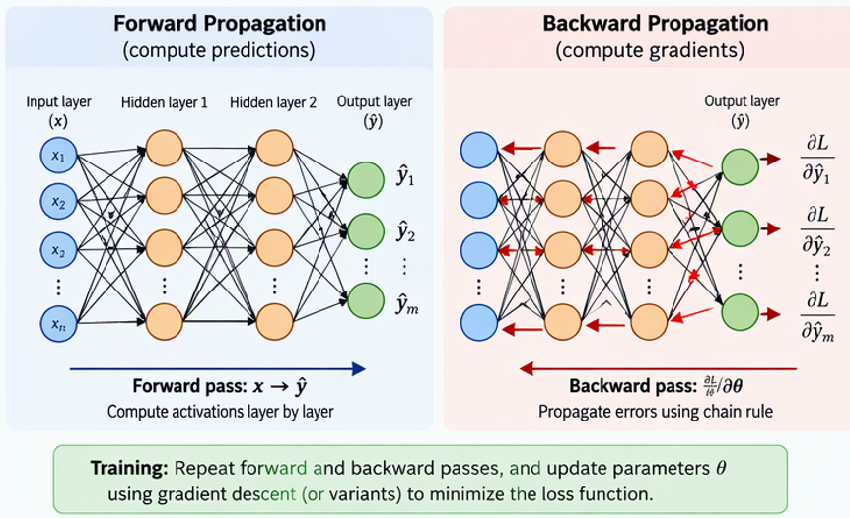
Basic idea of deep learning

Slide 29
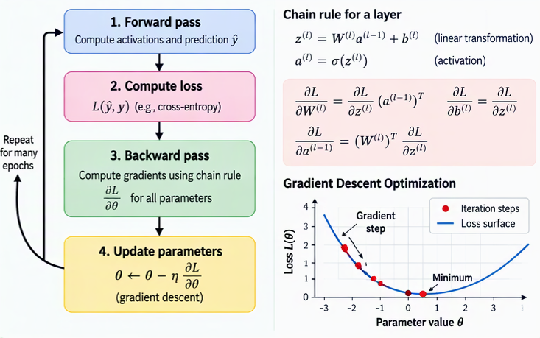
Backpropagation

Slide 30
A typical model for DNA sequence patterns
One-Hot DNA
Embedding
Convolutional Neural Network
Pooling
Multi Layer Perception+ReLU
Output logits

Slide 31
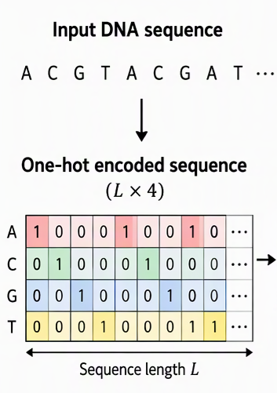
One-hot encoding and embedding
Encoding: yields a set of L orthogonal vectors in 4-dimensional space

Slide 32
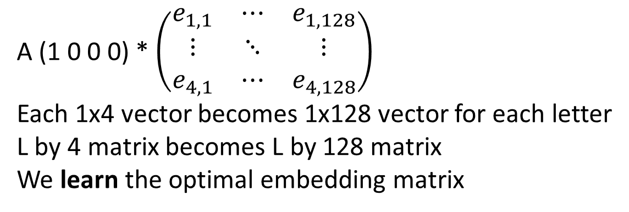
One-hot encoding and embedding
Embedding: yields set of L orthogonal vectors in M(e.g. 128)-dimensional space
A (1 0 0 0) * $\left(\begin{matrix}e_{1,1} & ⋯ & e_{1,128} \\ ⋮ & ⋱ & ⋮ \\ e_{4,1} & ⋯ & e_{4,128}\end{matrix}\right)$
Each 1x4 vector becomes 1x128 vector for each letter
L by 4 matrix becomes L by 128 matrix
We learn the optimal embedding matrix

Slide 33
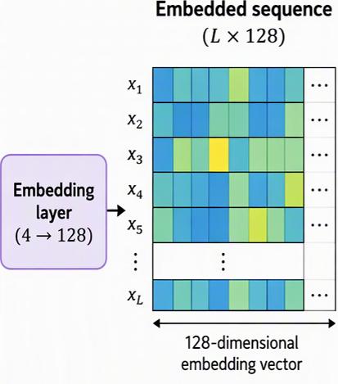
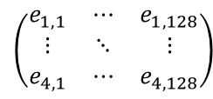
One-hot encoding and embedding
Embedding: yields set of L orthogonal vectors in M(e.g. 128)-dimensional space
$$\left(\begin{matrix}e_{1,1} & ⋯ & e_{1,128} \\ ⋮ & ⋱ & ⋮ \\ e_{4,1} & ⋯ & e_{4,128}\end{matrix}\right)$$

Slide 34
Convolutional Neural Networks
Apply learnable filters across input
Detect local motifs and patterns
Parameter sharing reduces model size
Excellent for sequence motif discovery

Slide 35
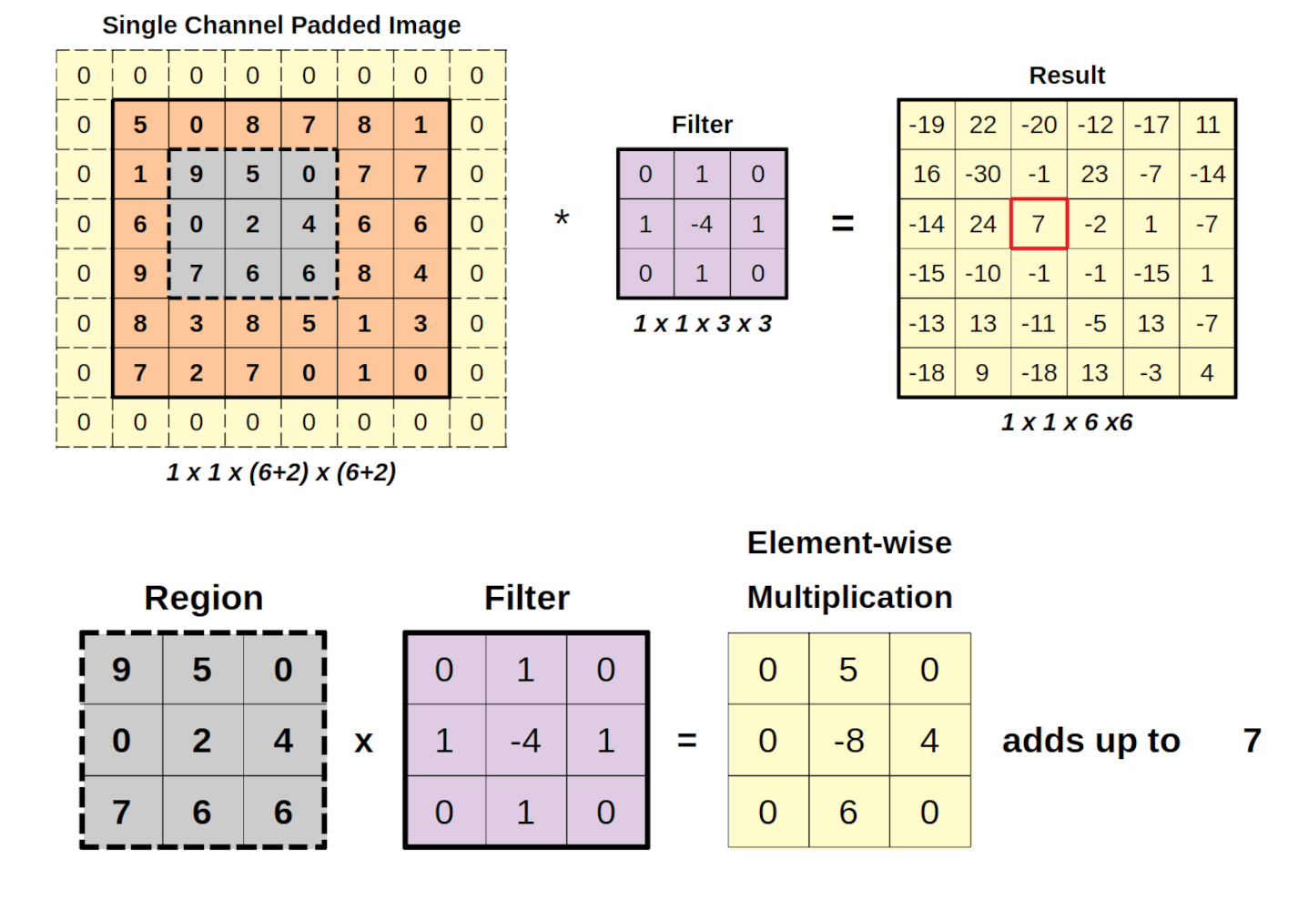
Convolutional neural network
Key idea: Learn local patterns via sliding filters (kernels) that perform element-wise multiplications (convolutions) with the input:
For DNA we will be using 1-D
convolution; kernel size K by 128
Perform element-wise multiplication
followed by summation and reduce
L by 128 matrix to L by C, where C is
the number of convolution channels

Slide 36
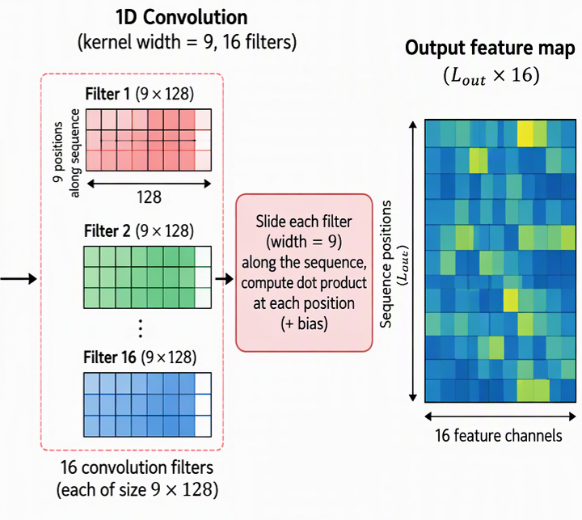
Convolutional neural network
Convolution: yields a set of L vectors in 16-dimensional space, learns local features

Slide 37
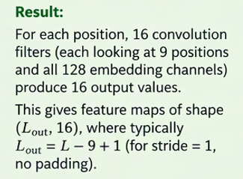
Convolutional neural network

Slide 38
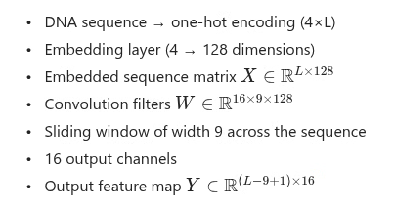
Convolutional neural network
Recap

Slide 39
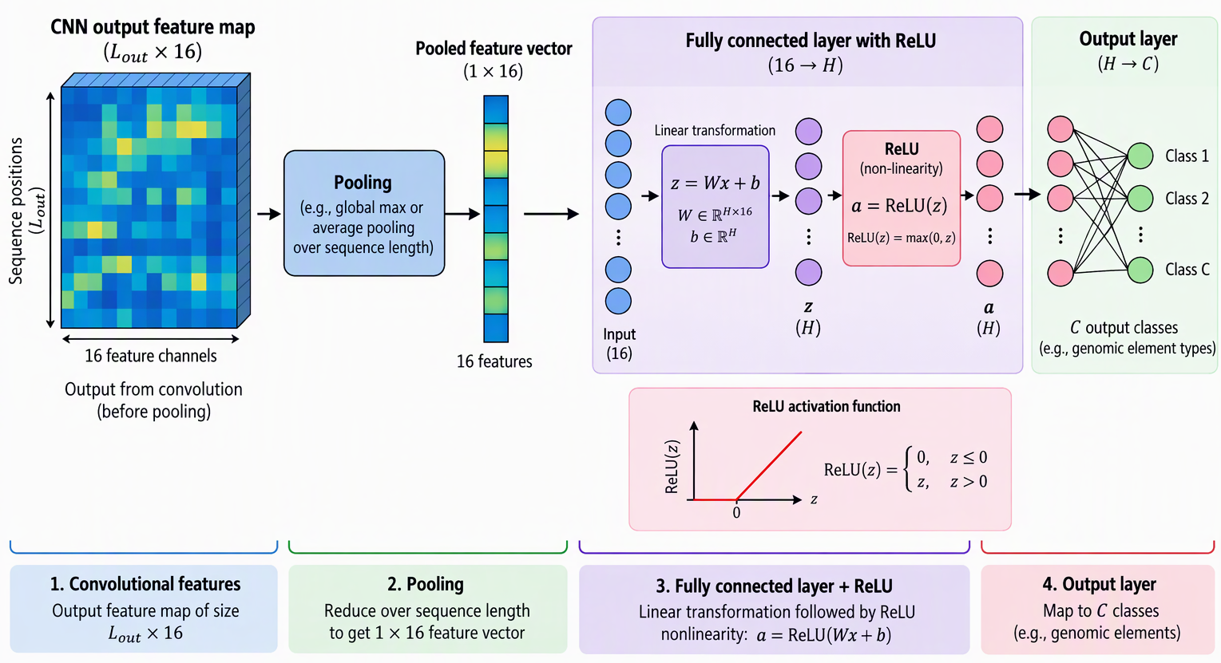
Pooling
Feature map is followed by Maximum Pooling to flatten it into a vector
Each channel usually represents a learned sequence pattern e.g.:
Channel 1: donor motif detector
Channel 2: acceptor motif detector
Channel 3: branch-point detector
...
Channel 16: some higher-order feature
One can for example take the maximum value across all sequence positions
This asks: Did motif detector C fire anywhere in the sequence?

Slide 40
Fully connected+nonlinearity
Maximum Pooling followed by fully connected (MLP) + nonlinearity

Slide 41
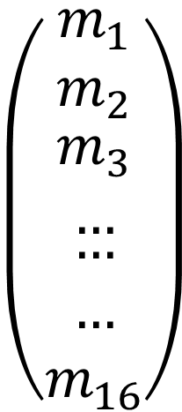
Fully connected layer(s)
Pooled vector is followed by one or more fully connected layers
$$\left(\begin{matrix}m_{1} \\ m_{2} \\ \begin{matrix}m_{3} \\ … \\ \begin{matrix}… \\ … \\ m_{16}\end{matrix}\end{matrix}\end{matrix}\right)$$

Slide 42
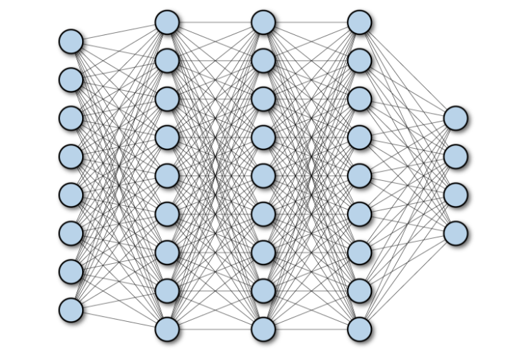
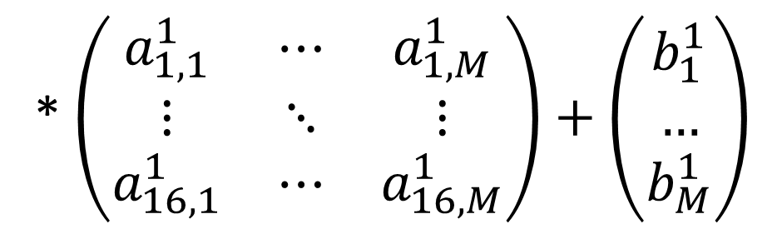
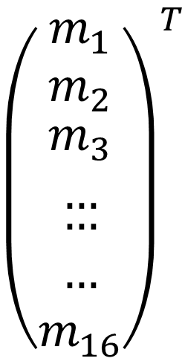
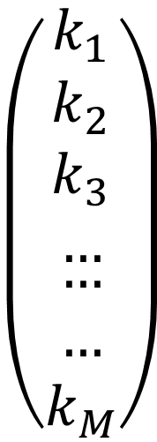
Fully connected Layer
Pooling is followed up with one or more MLP (fully connected) layers
$${\left(\begin{matrix}m_{1} \\ m_{2} \\ \begin{matrix}m_{3} \\ … \\ \begin{matrix}… \\ … \\ m_{16}\end{matrix}\end{matrix}\end{matrix}\right)}^{T}$$
$$\left(\begin{matrix}k_{1} \\ k_{2} \\ \begin{matrix}k_{3} \\ … \\ \begin{matrix}… \\ … \\ k_{M}\end{matrix}\end{matrix}\end{matrix}\right)$$
* $\left(\begin{matrix}a_{1,1}^{1} & ⋯ & a_{1,M}^{1} \\ ⋮ & ⋱ & ⋮ \\ a_{16,1}^{1} & ⋯ & a_{16,M}^{1}\end{matrix}\right)+\left(\begin{matrix}b_{1}^{1} \\ … \\ b_{M}^{1}\end{matrix}\right)$

Slide 43
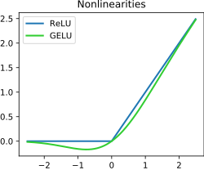


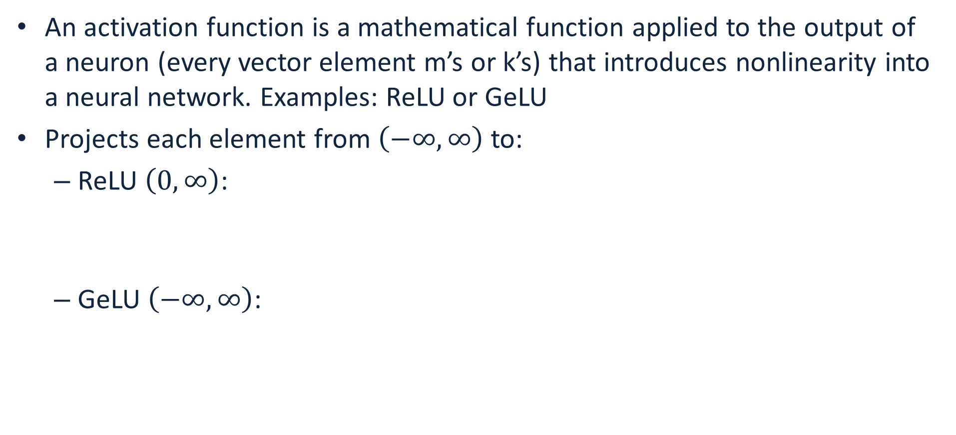
Nonlinearities: ReLU/GeLU
An activation function is a mathematical function applied to the output of a neuron (every vector element m’s or k’s) that introduces nonlinearity into a neural network. Examples: ReLU or GeLU
Projects each element from $\left(−∞,∞\right)$ to:
  ReLU $\left(0,∞\right)$:
  GeLU $\left(−∞,∞\right)$:

Slide 44
Why do we need: ReLU/GeLU
The main reason is that without a nonlinearity such as ReLU or GELU, a deep neural network collapses into a single linear transformation.

Slide 45
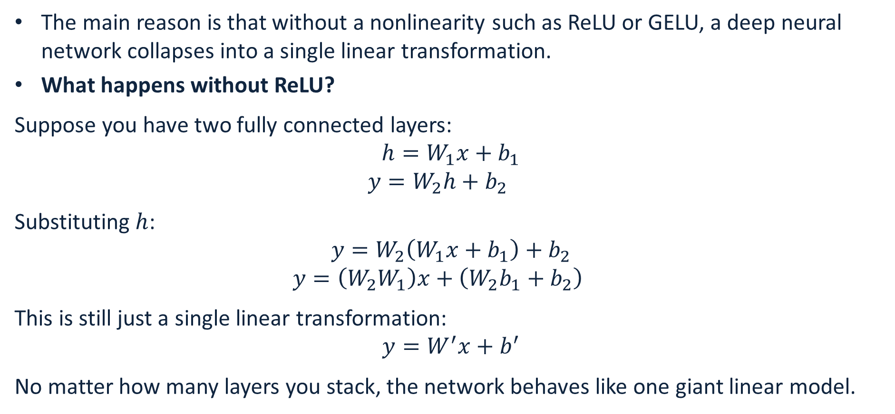
Why do we need: ReLU/GeLU
The main reason is that without a nonlinearity such as ReLU or GELU, a deep neural network collapses into a single linear transformation.
What happens without ReLU?
Suppose you have two fully connected layers:
$$h=W_{1}x+b_{1}$$
$$y=W_{2}h+b_{2}$$
Substituting $h$:
$$y=W_{2}\left(W_{1}x+b_{1}\right)+b_{2}$$
$$y=\left(W_{2}W_{1}\right)x+\left(W_{2}b_{1}+b_{2}\right)$$
This is still just a single linear transformation:
$$y=W^{′}x+b^{′}$$
No matter how many layers you stack, the network behaves like one giant linear model.

Slide 46
Fully connected Layer
Pooling is followed up with one or more MLP (fully connected) layers
$${\left(\begin{matrix}m_{1} \\ m_{2} \\ \begin{matrix}m_{3} \\ … \\ \begin{matrix}… \\ … \\ m_{16}\end{matrix}\end{matrix}\end{matrix}\right)}^{T}$$
$$\left(\begin{matrix}k_{1} \\ k_{2} \\ \begin{matrix}k_{3} \\ … \\ \begin{matrix}… \\ … \\ k_{M}\end{matrix}\end{matrix}\end{matrix}\right)$$
* $\left(\begin{matrix}a_{1,1}^{1} & ⋯ & a_{1,M}^{1} \\ ⋮ & ⋱ & ⋮ \\ a_{16,1}^{1} & ⋯ & a_{16,M}^{1}\end{matrix}\right)+\left(\begin{matrix}b_{1}^{1} \\ … \\ b_{M}^{1}\end{matrix}\right)$

Slide 47
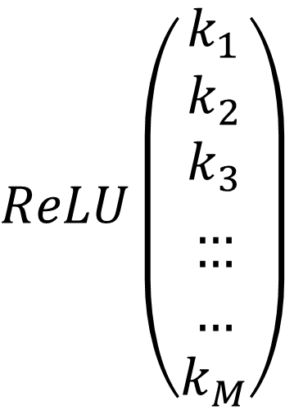
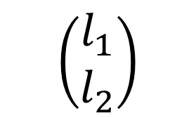
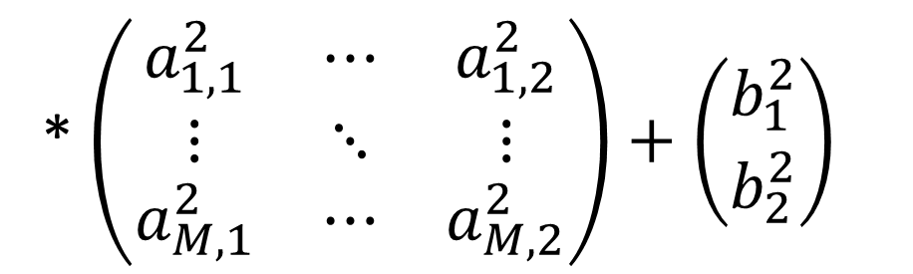
Final layer projects output logits
After nonlinearity (e.g.ReLU/GeLU) output layer produces output logits
$$ReLU\left(\begin{matrix}k_{1} \\ k_{2} \\ \begin{matrix}k_{3} \\ … \\ \begin{matrix}… \\ … \\ k_{M}\end{matrix}\end{matrix}\end{matrix}\right)$$
* $\left(\begin{matrix}a_{1,1}^{2} & ⋯ & a_{1,2}^{2} \\ ⋮ & ⋱ & ⋮ \\ a_{M,1}^{2} & ⋯ & a_{M,2}^{2}\end{matrix}\right)+\left(\begin{matrix}b_{1}^{2} \\ b_{2}^{2}\end{matrix}\right)$
$$\left(\begin{matrix}l_{1} \\ l_{2}\end{matrix}\right)$$

Slide 48
Full flow following CNN

Slide 49
Model size
Model size is number or parameters to learn
Equal to the number of elements in the matrices (a’s, b’s, embedding matrix and all convolution kernels)

Slide 50
Other layers: Transformer or SSM?
Other useful models from language modeling:
  Transformers:
    Large number of parameters (~sequence window²)
    Similar to database lookup
  State Space models (Mamba 2,3)
    Large number of parameters (~sequence window)
    Similar to brain (thinking)

